Slide 1


Google Machine Learning courses
Notes:
https://developers.google.com/machine-learning/crash-course

Slide 2
What you will learn
Linear Regression
Logistic Regression
Classification
Working with Numerical Data
Working with Categorical Data
Datasets, Generalization, and Overfitting
Neural Networks
Embeddings
Large Language Models
Production ML Systems
AutoML
ML Fairness

Slide 3
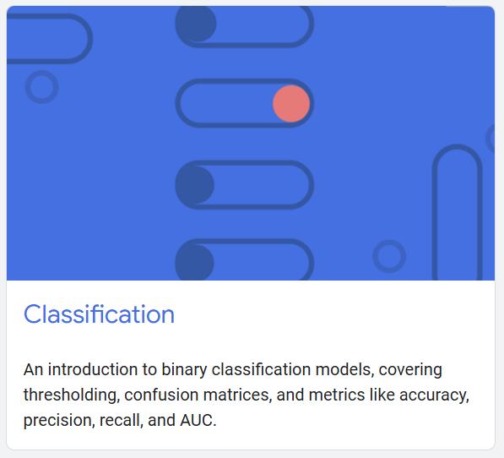
Classification
Notes:
https://developers.google.com/machine-learning/crash-course/classification

Slide 4
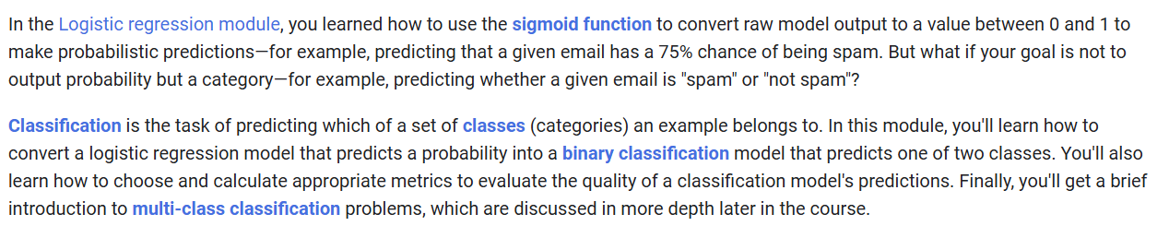

Slide 5
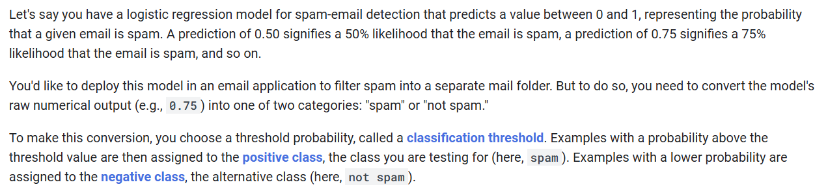

Slide 6
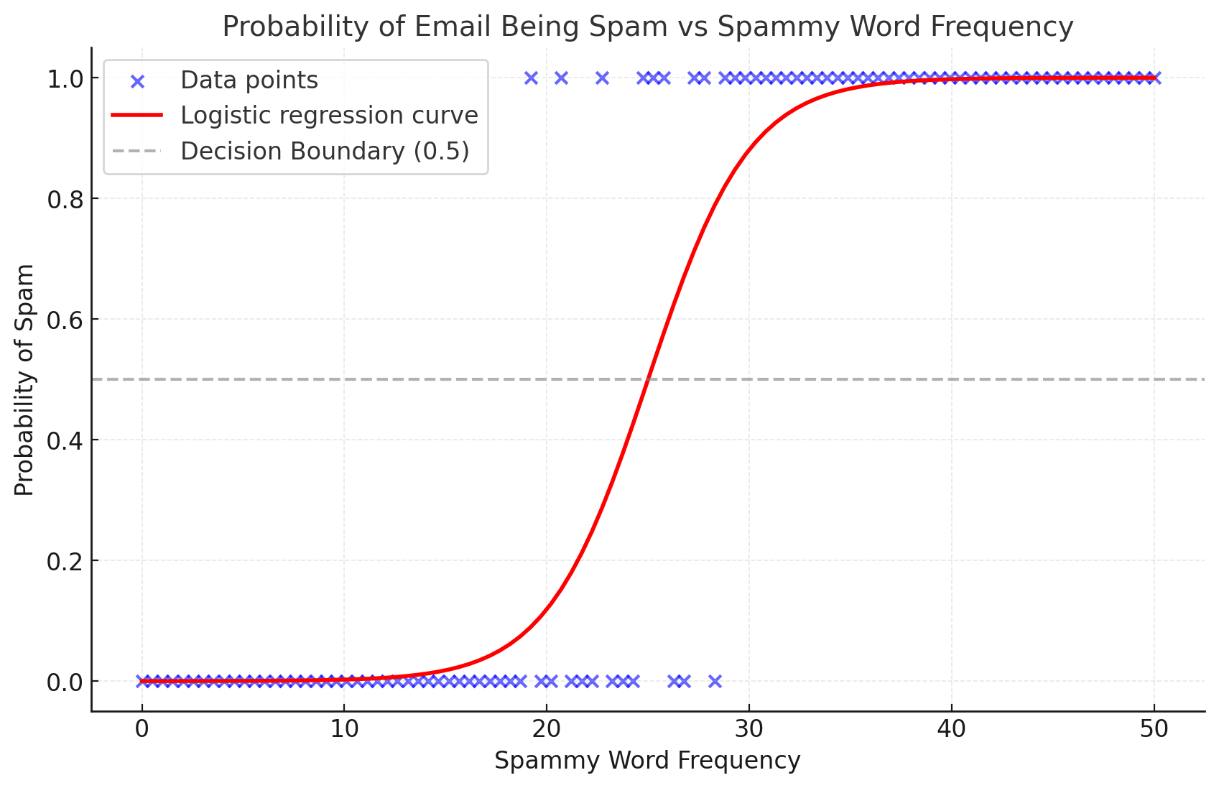

Slide 8
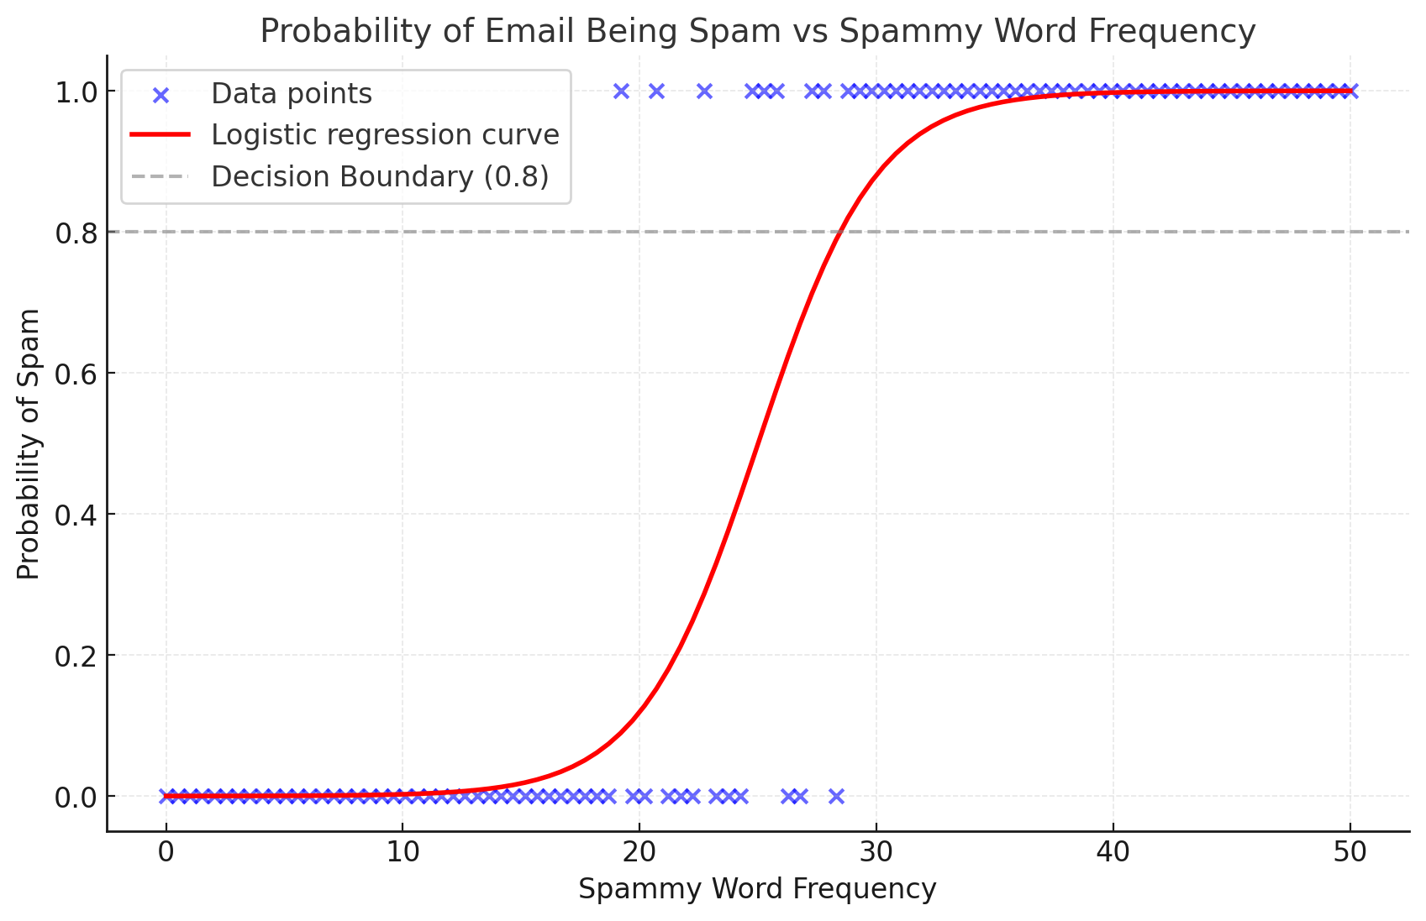

Slide 9




Notes:
https://www.youtube.com/channel/UC35ZpwldGw7ZJ5R-2sLijzw

Slide 10
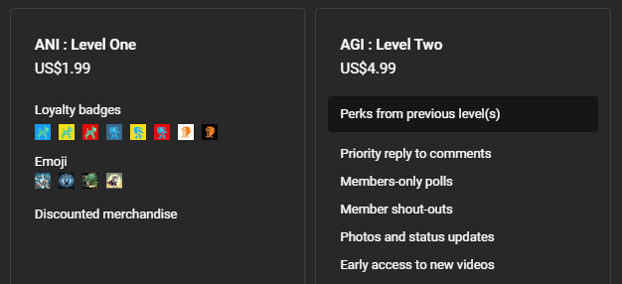

Membership has its privileges
Notes:
https://www.youtube.com/channel/UC35ZpwldGw7ZJ5R-2sLijzw/join

Slide 11

https://www.youtube.com/@AINewsFresh

Slide 12

https://www.youtube.com/@DailyAINewsPodcast

Slide 13

https://www.youtube.com/@AIPapersPodcastDaily

Slide 14
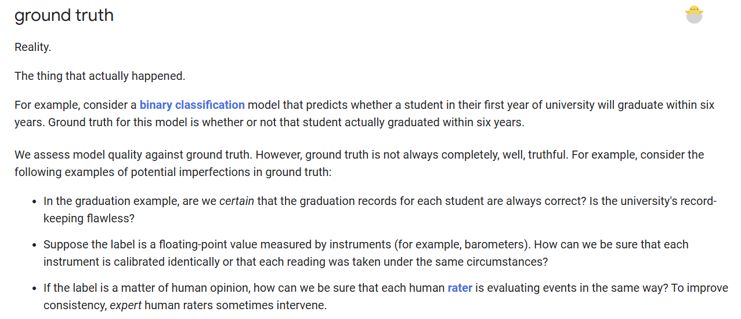

Slide 15
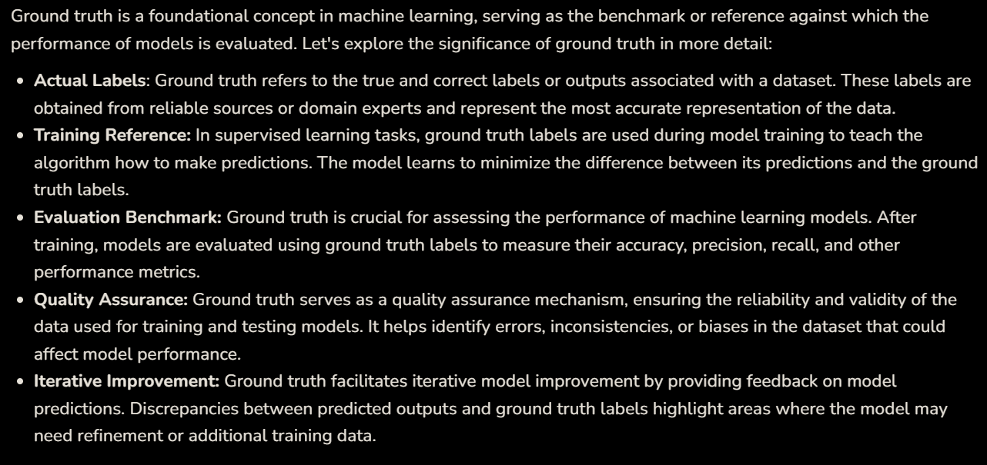
Notes:
https://www.geeksforgeeks.org/what-is-ground-truth-in-machine-learning/

Slide 16
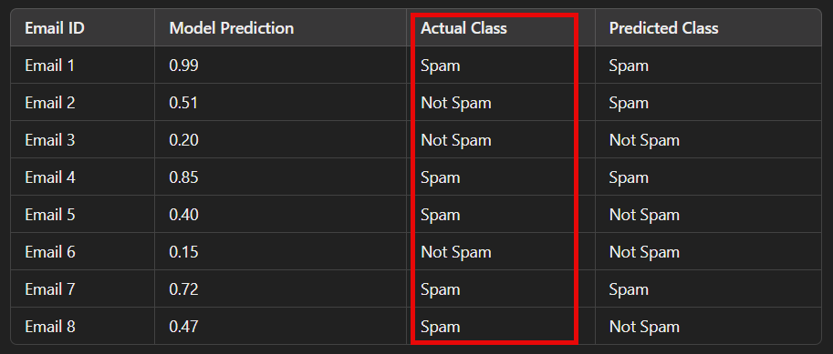

Slide 17
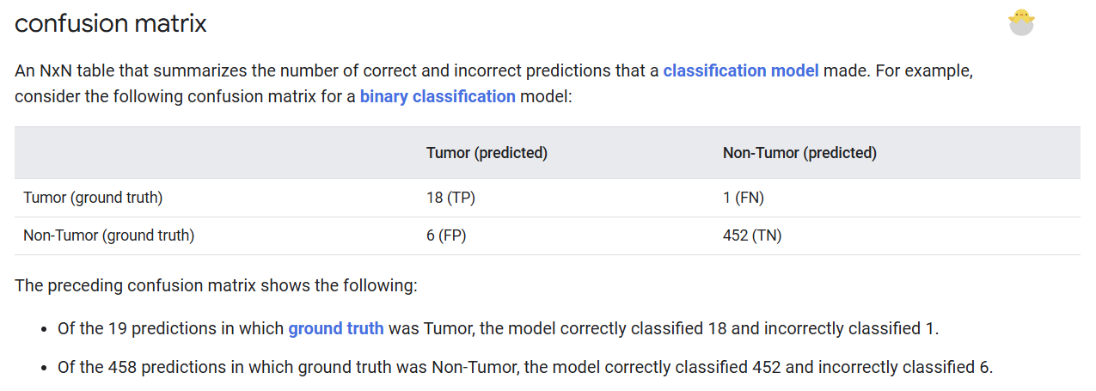

Slide 18
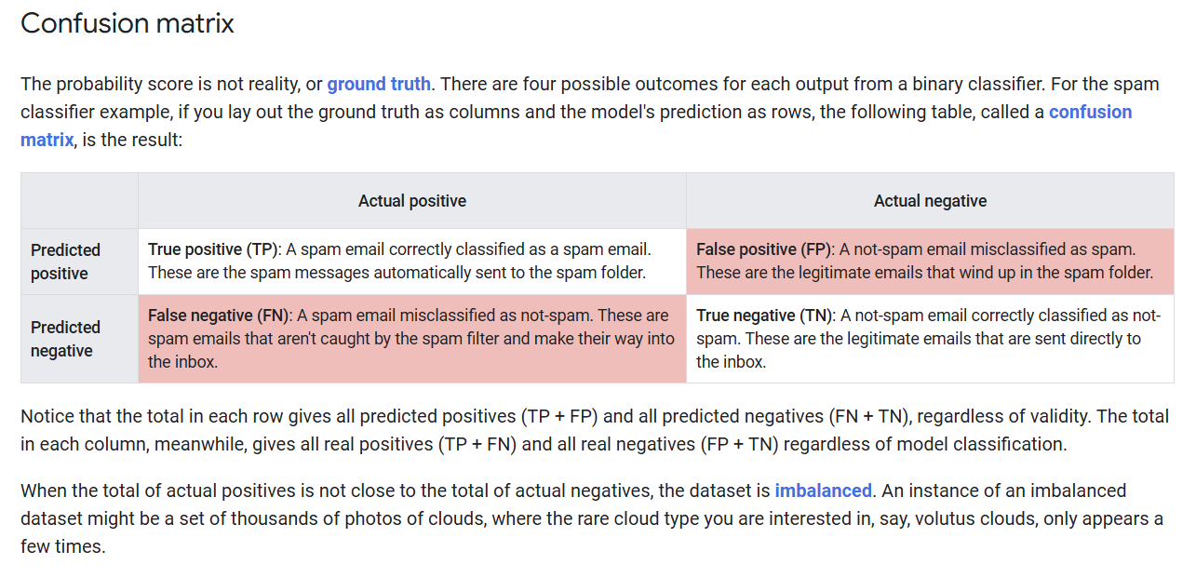

Slide 19
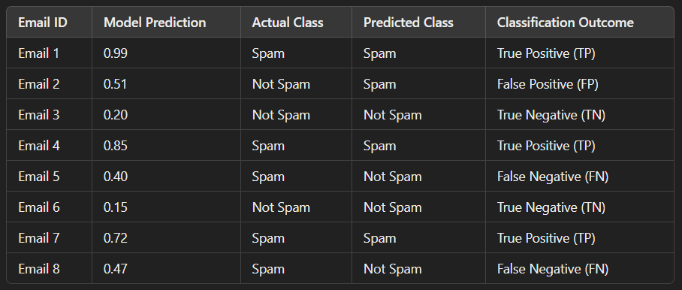

Slide 20
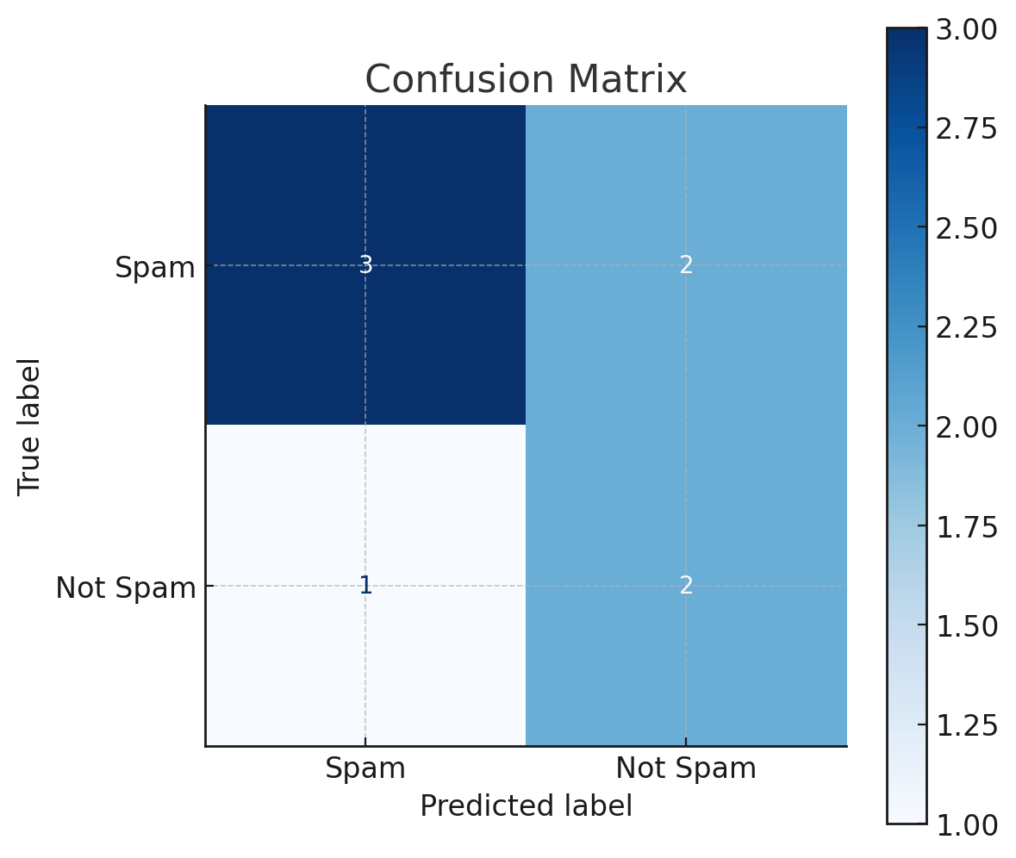

Slide 21
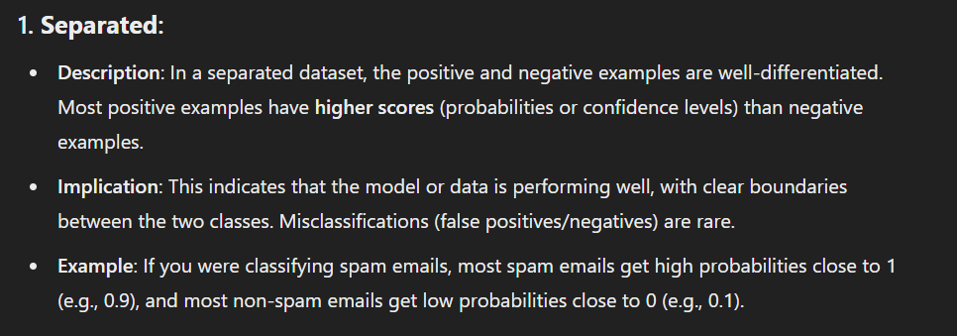
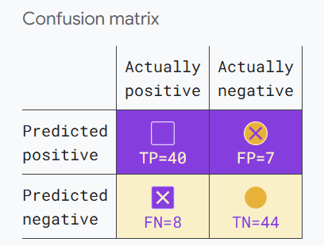

Slide 22
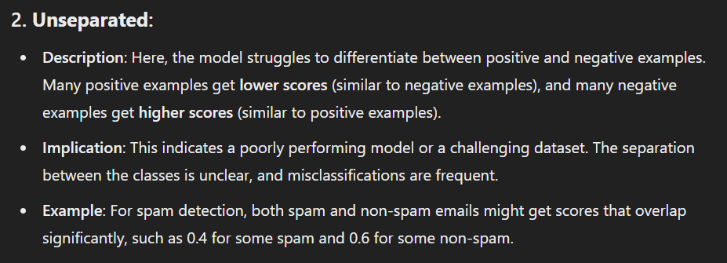
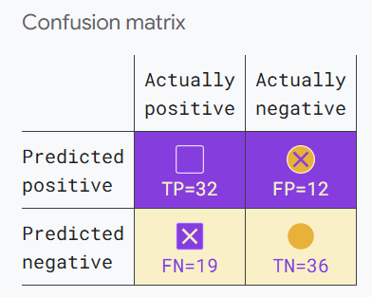

Slide 23
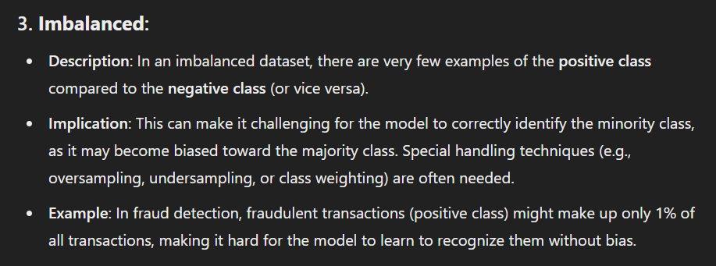
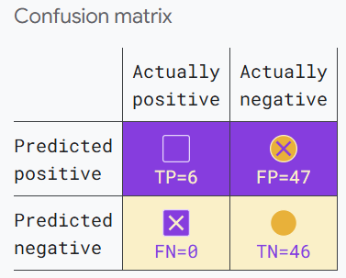

Slide 25
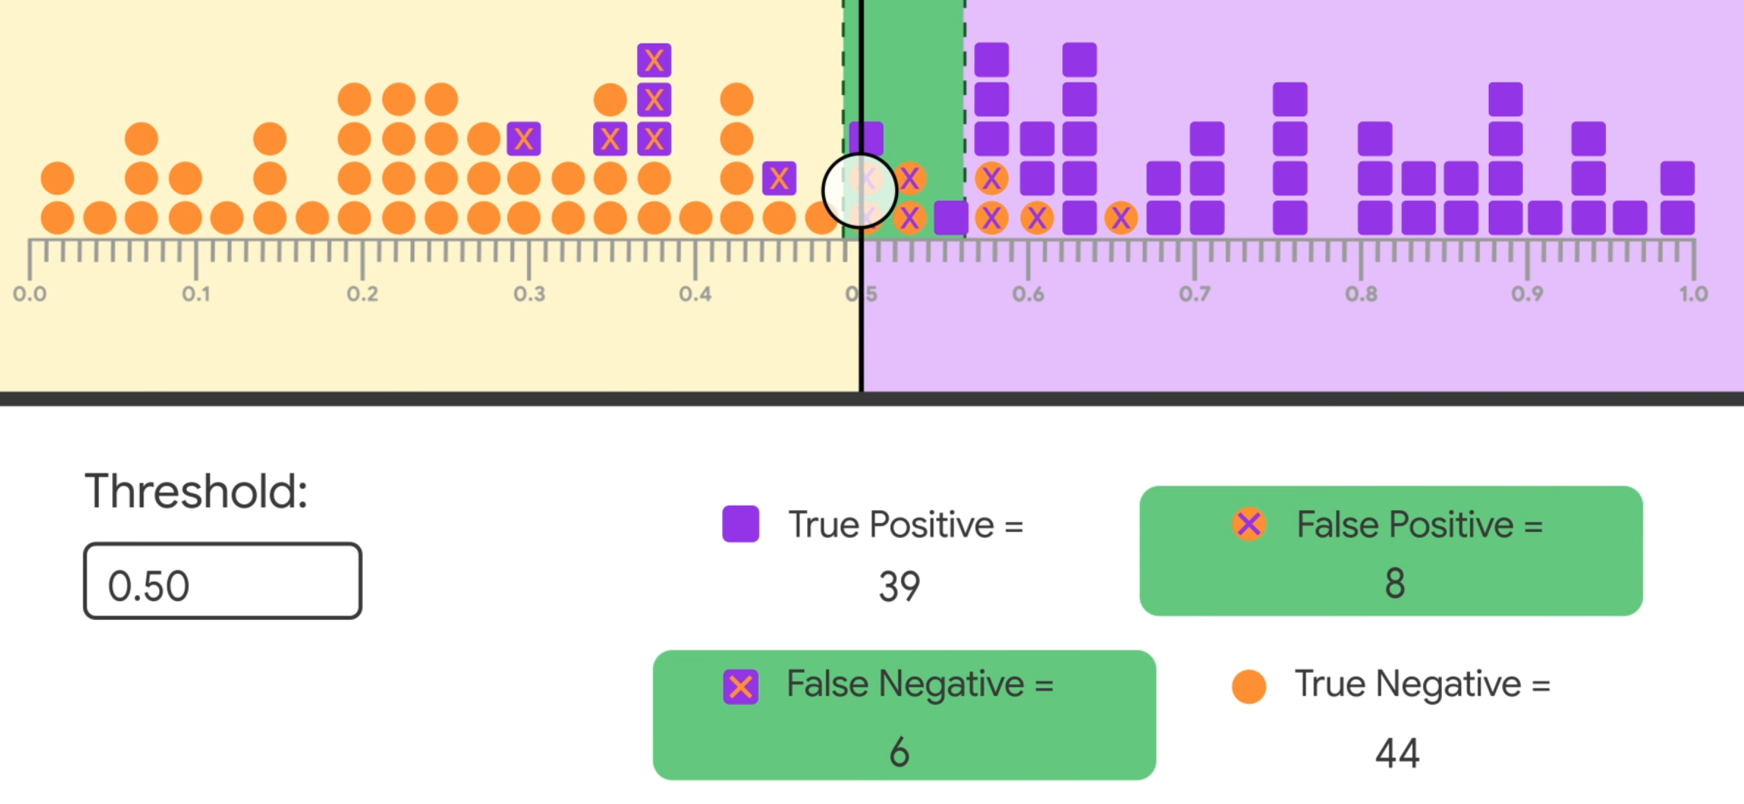

Slide 26
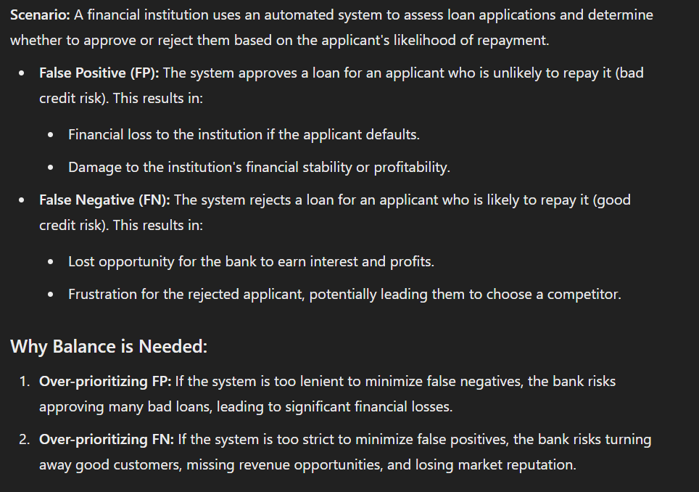

Slide 27
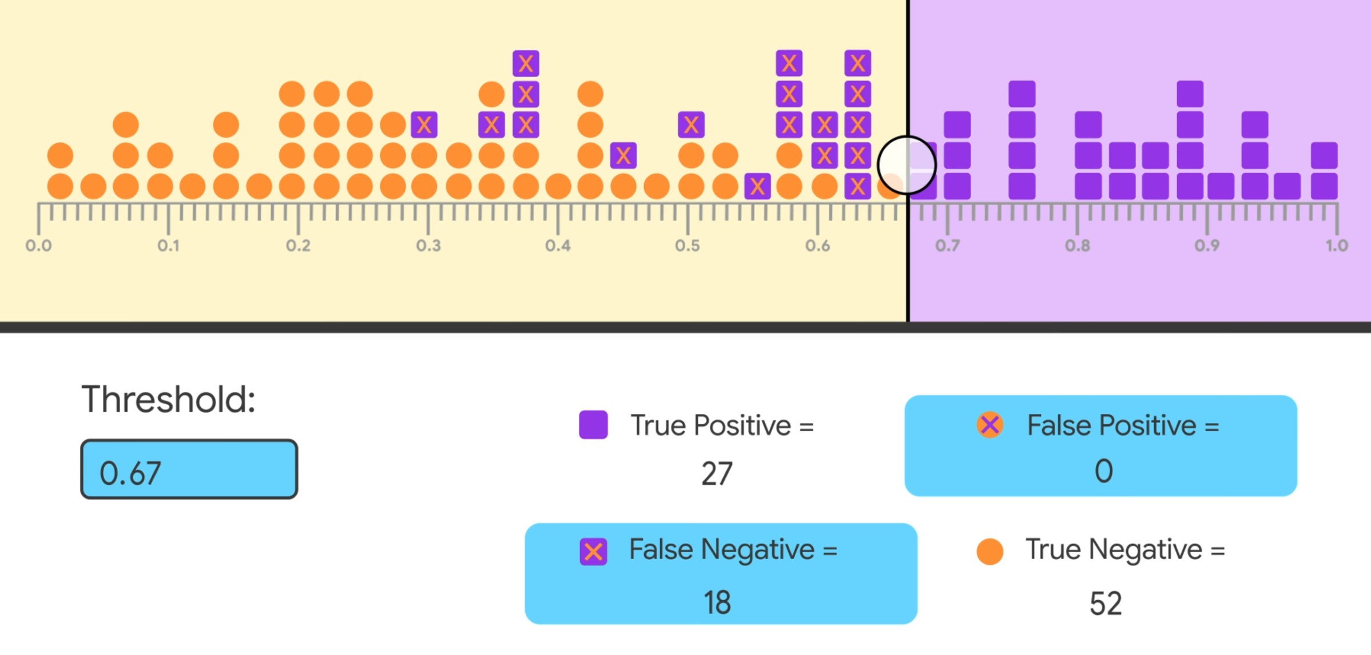

Slide 28
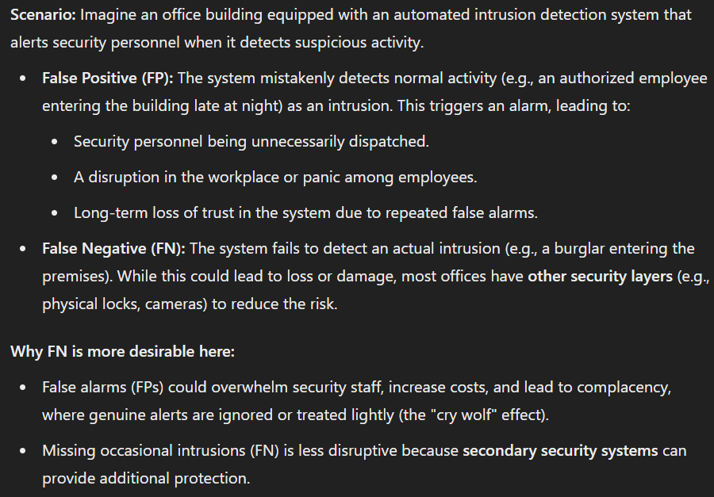

Slide 29
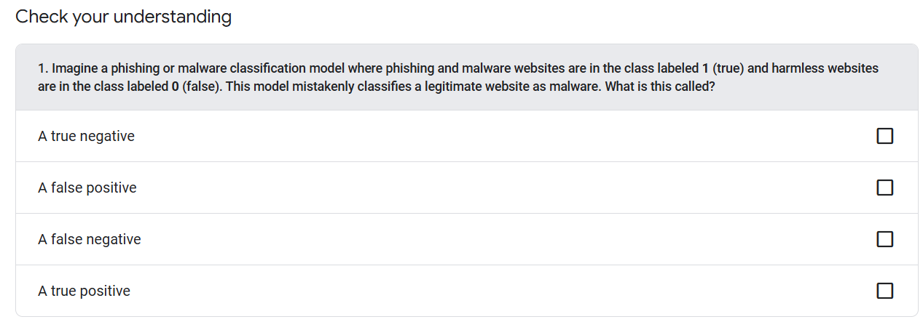

Slide 30
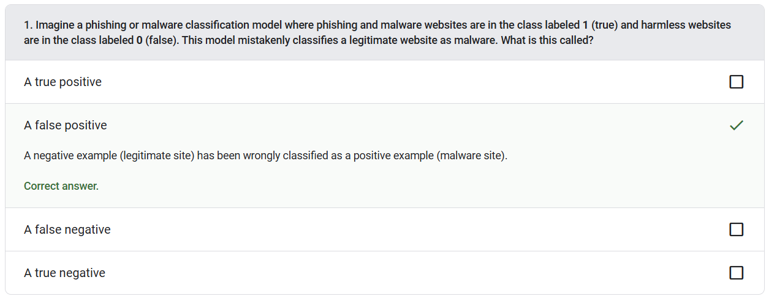

Slide 31
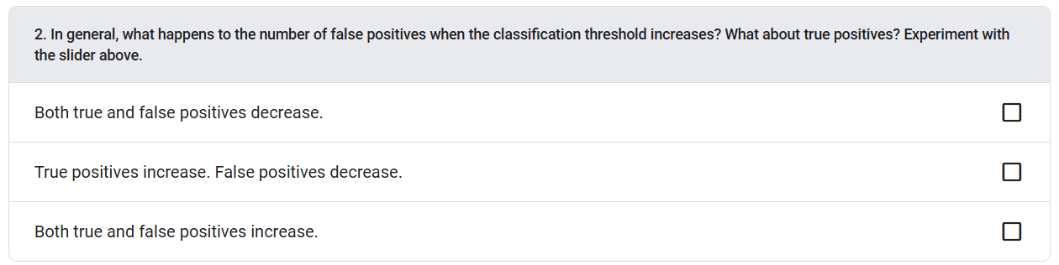

Slide 32
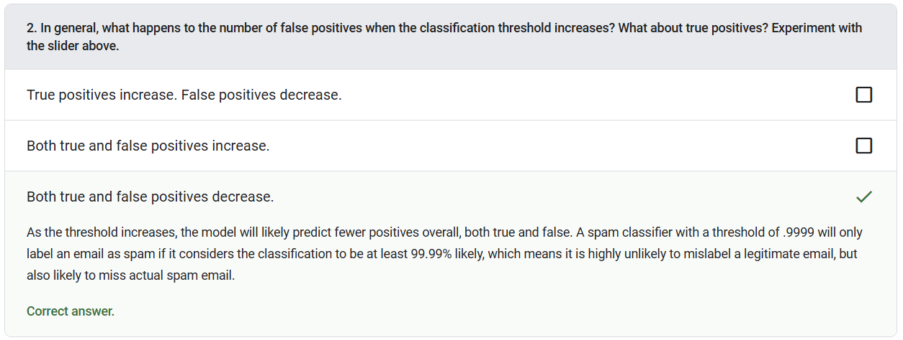

Slide 33
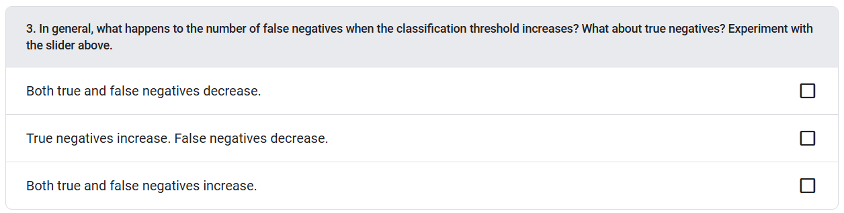

Slide 34
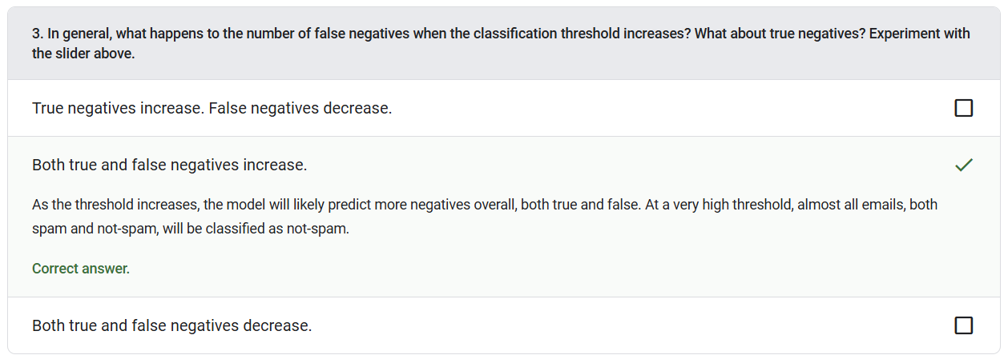

Slide 35
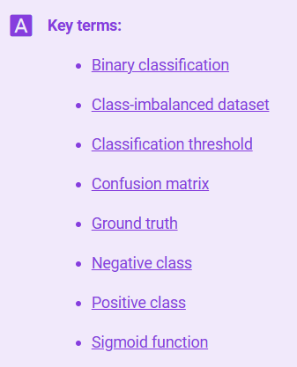
Notes:
https://developers.google.com/machine-learning/glossary

Slide 36


